Slide 1
Winter 25-26 PS -Robotic Sensing and Knowledge Transfer Learning in Safety-Critical Environments 3 – Deep Reinforcement Learning Model-Free Methods-Model-Based
Prof. Dr. Holger Giese (Holger.Giese@hpi.de)
Christian Medeiros Adriano (Christian.Adriano@hpi.de) - “Chris”
Dr. Sona Ghahremani (Sona.Ghahremani@hpi.de)
Finn Kaiser (Finn.Kaiser@hpi.de)
He Xu (He.Xu@hpi.de)
Mustafa Ghani (Mustafa.Ghani@hpi.de)

Slide 2
The Problem of Reinforcement Learning
Learn to Make Decisions by Interacting with an Environment

Slide 3
Recap
"When solving a problem of interest, do not solve a more general problem as an intermediate step“
Vladimir Vapnik [1]
Notes:
https://en.wikipedia.org/wiki/Transduction_(machine_learning)
https://stats.stackexchange.com/questions/568821/is-there-a-good-illustrative-example-where-the-hinge-loss-svm-gives-a-higher-a
Vapnik wrote this in the context of transductive learning, but the principle could also be applied to statistical pattern recognition tasks. If we just need to perform a hard classification, then we should aim to determine the decision boundary directly, rather than estimating the posterior probability of class membership and then threshold that at 0.5 (or some other threshold depending on the misclassification costs).
In principle, we may be able to get better generalisation in terms of accuracy by following this principle as it focusses on the needs of the application, and avoids modelling compromises that benefit modelling of aspects of the data that are not relevant to the application at the expense of other aspects that are.

Slide 4
Topics
Review of MDP Learning Algorithms
Concepts
Model-based algorithms (Value or Policy iteration)
Model-free algorithms (Sarsa and Q-Learning)
Model-based architectures
Dyna-Q
POMDP / Hidden-Markov Models

Slide 5
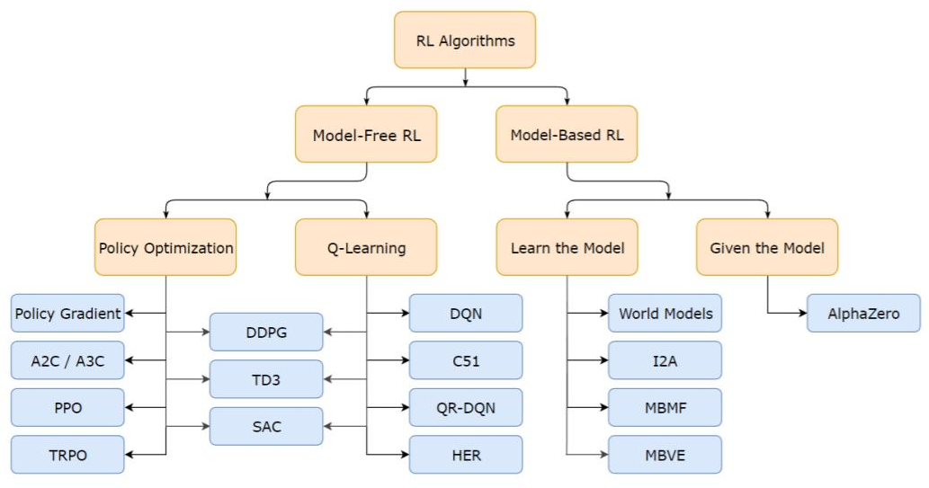
Brief Taxonomy of RL Methods

Slide 6
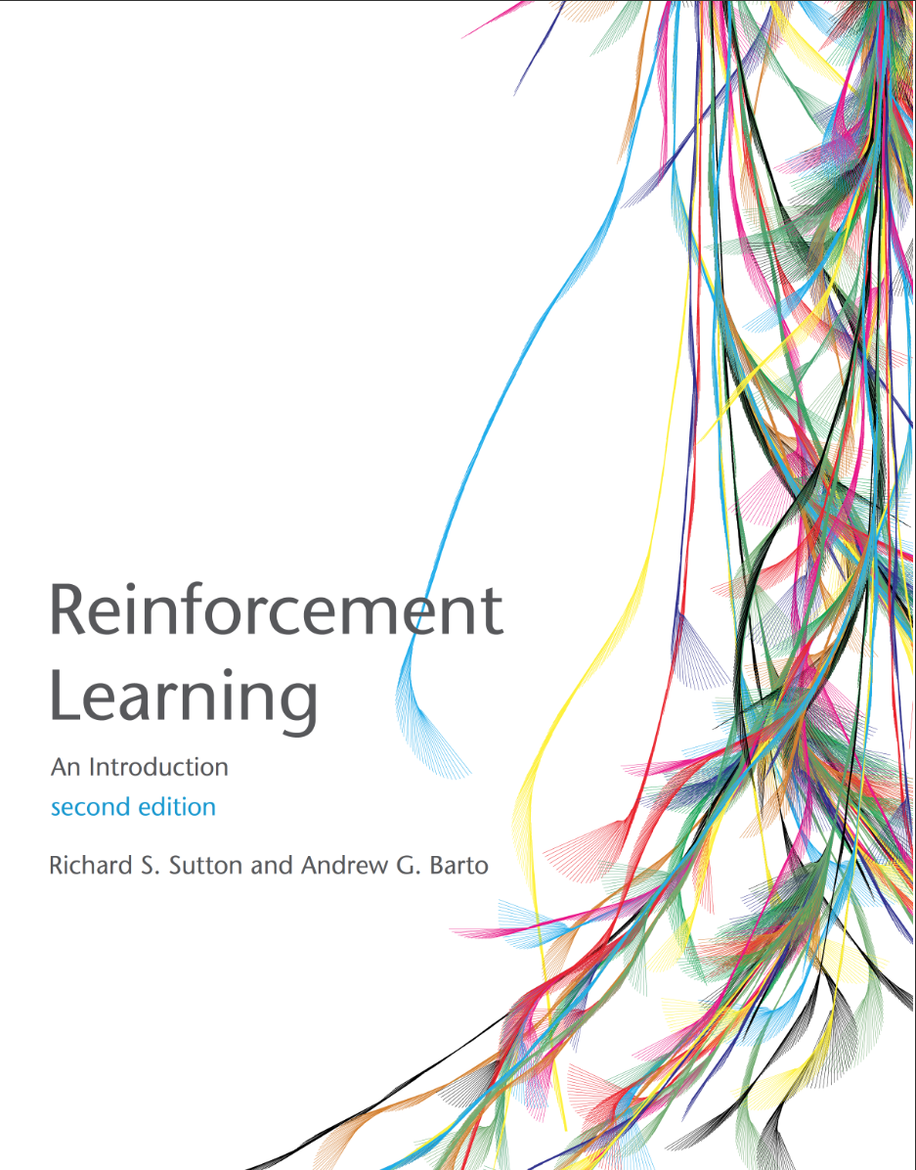
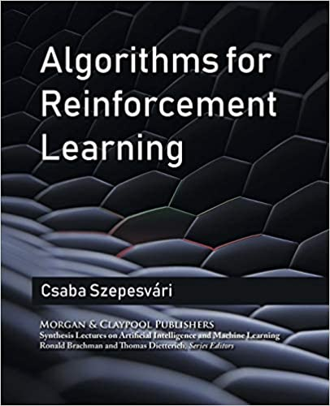

Resources used
Sutton, R. S., & Barto, A. G. (2015). Reinforcement learning: An introduction. MIT press. http://richsutton.com
Csaba Szepesvári (2010). Algorithms for reinforcement learning Morgan and Claypool. https://sites.ualberta.ca/~szepesva/rlbook.html
Lectures at UCL from DeepMind Research Scientists:
David Silver, 2015, https://www.davidsilver.uk/wp-content/uploads/2020/03/MC-TD.pdf
Hado Van Hansselt, 2018 https://www.youtube.com/watch?v=nnxHlg-2WgA&list=PLqYmG7hTraZBKeNJ-JE_eyJHZ7XgBoAyb&index=4
https://www.deepmind.com/learning-resources/reinforcement-learning-lecture-series-2021
Notes:
https://www.microsoft.com/en-us/research/blog/exploring-the-fundamentals-of-multi-armed-bandits/

Slide 7
Basic concepts - Structure
Agent: external to the environment, take actions and has access to external states
Environment: constrains the agent, has hidden and visible states
State: visible information about the environment after an action was taken
Reward: value obtained after taking an action or being at a state
Action: taken by an agent, might cause a change in state
Goal: Maximize rewards by using an optimal policy
Policy: set of state action pairs
Markov property: we only need to know the current state to predict the next state

Slide 8
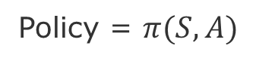
Agent and Environment Interaction
Action
Agent
Environment
State
Reward
Agent’s Goal: Maximize its reward
Our Goal: Discover a strategy that allows the agent to achieve its goal under various circumstances
Search, Estimate, Learn
Policy = $π(S,A)$
knowlege about the environment

Slide 9
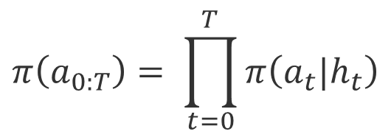
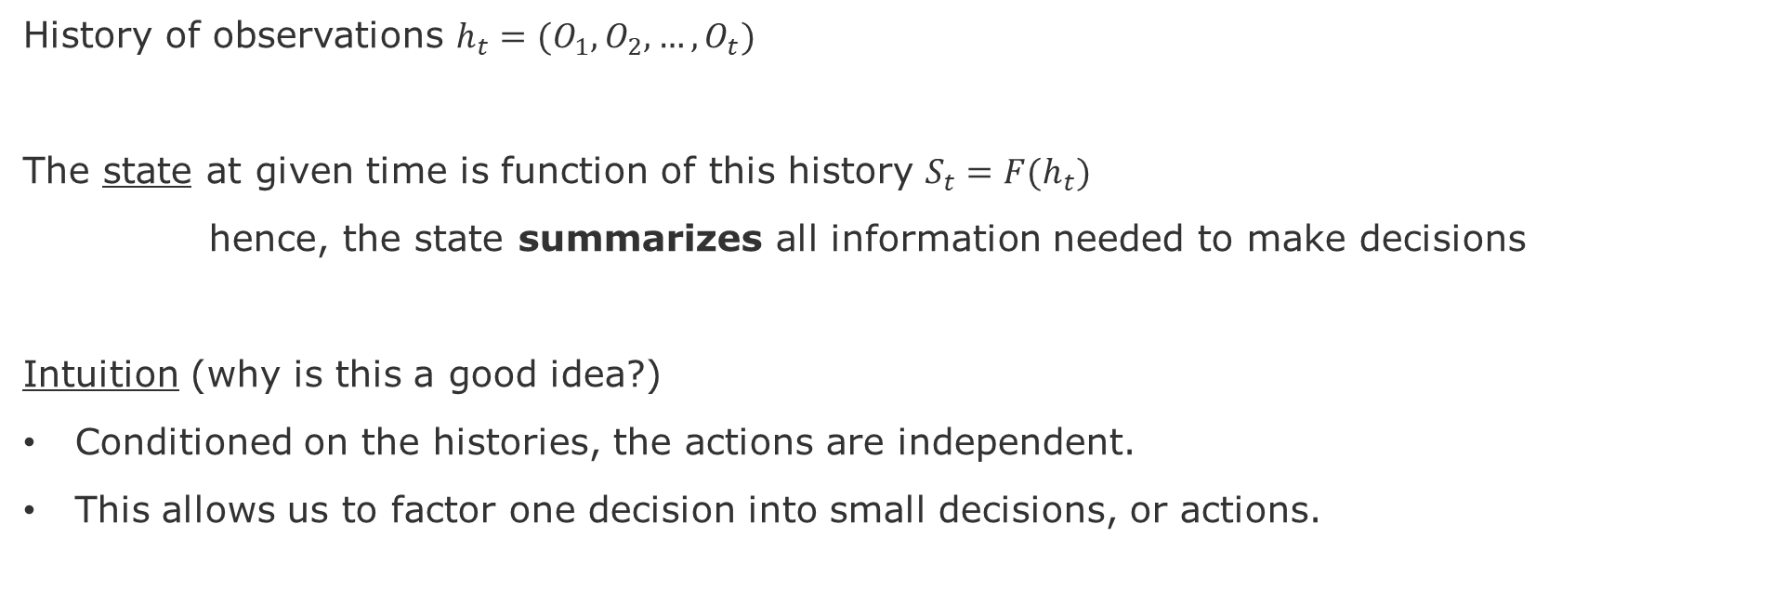
State
History of observations $h_{t}=(O_{1},O_{2}, …,O_{t})$
The state at given time is function of this history $S_{t}=F(h_{t})$
hence, the state summarizes all information needed to make decisions
Intuition (why is this a good idea?)
Conditioned on the histories, the actions are independent.
This allows us to factor one decision into small decisions, or actions.
$$π\left(a_{0:T}\right)= \prod_{t=0}^{T}{π\left(a_{t}|h_{t}\right)}$$

Slide 10
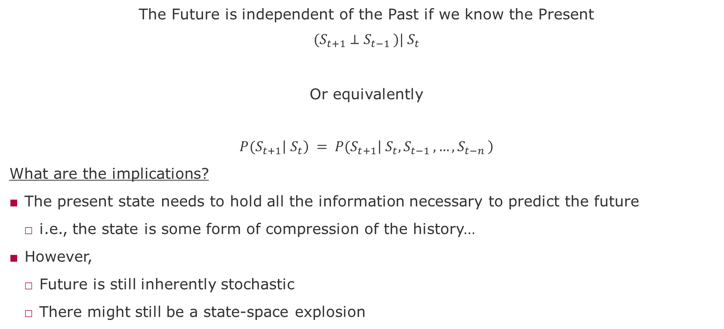
Markov Property
The Future is independent of the Past if we know the Present
$${(S}_{t+1} ⊥S_{t−1 })|{ S}_{t}$$
Or equivalently
$${P(S}_{t+1}\left|{ S}_{t}\right) = {P(S}_{t+1}\left|{ S}_{t},S_{t−1 },…,S_{t−n }\right)$$
What are the implications?
The present state needs to hold all the information necessary to predict the future
i.e., the state is some form of compression of the history…
However,
Future is still inherently stochastic
There might still be a state-space explosion
The History does not make any difference

Slide 11
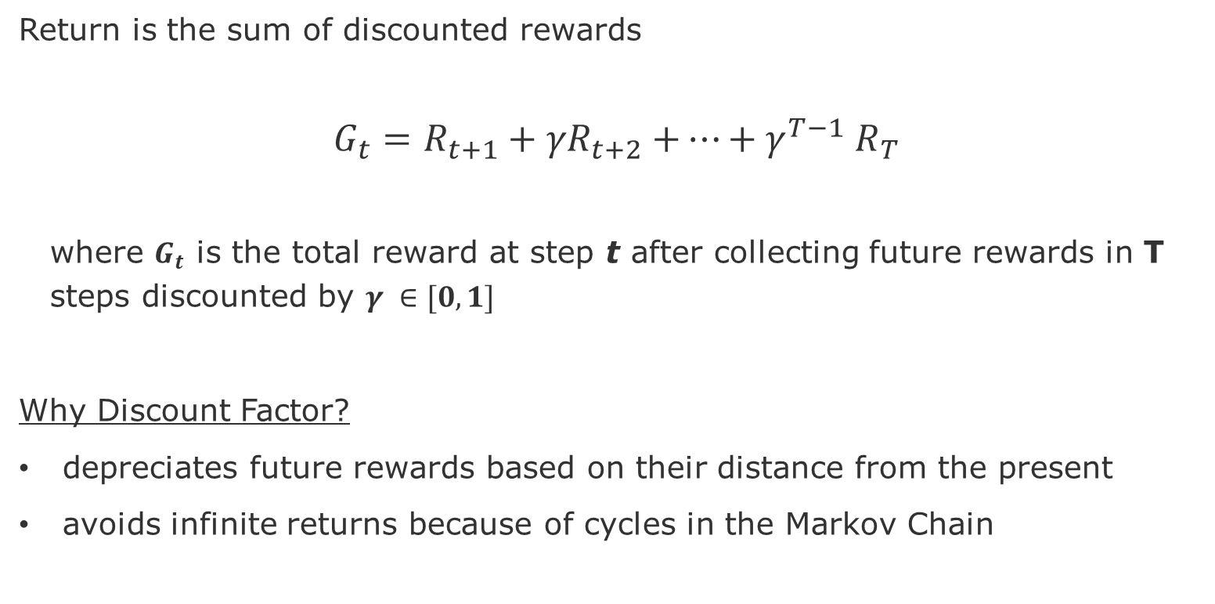
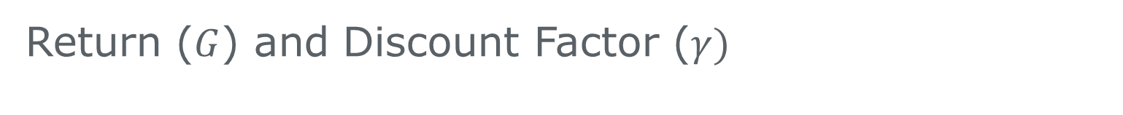
Return ($G$) and Discount Factor ($γ)$
Return is the sum of discounted rewards
$$G_{t}=R_{t+1}+{γR}_{t+2}{+…+γ}^{T−1}R_{T}$$
where $G_{t}$ is the total reward at step t after collecting future rewards in T steps discounted by $γ ∈[0,1]$
Why Discount Factor?
depreciates future rewards based on their distance from the present
avoids infinite returns because of cycles in the Markov Chain

Slide 12
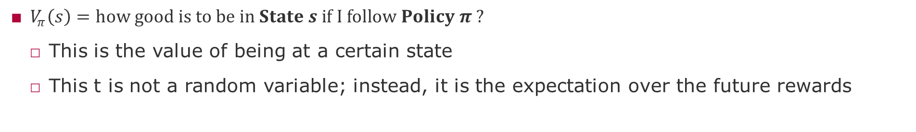
State Value Function
$V_{π}\left(s\right)=how good is to be in State s if I follow Policy π ?$
This is the value of being at a certain state
This t is not a random variable; instead, it is the expectation over the future rewards

Slide 13
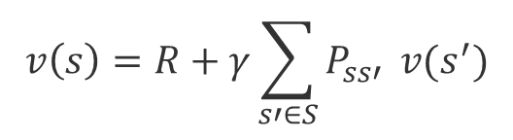
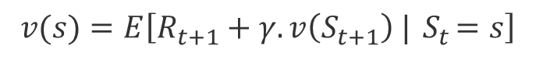
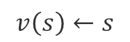
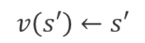
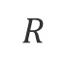
Bellman Equation
The value of being in a certain state is an average of:
The reward of leaving the state t
Value of being at a next state t+1
$$v(s)=E\left[R_{t+1}+γ.v\left(S_{t+1}\right) |{ S}_{t}=s\right]$$
$$v\left(s\right)←s$$
$$R$$
$$v\left(s′\right)←s′$$
One-Step Lookahead idea
$$v\left(s\right)=R+γ\sum_{s′∈S}{P_{ss′}} v(s^{′})$$

Slide 14
Bellman Optimatility Equation
How to find the best path in the MDP?
Bellman equation estimates V(s) by looking ahead of possible future trajectories in the state-space
Intuition
If we behave optimally for the first step and then also behave optimally for the next step, we will find the optimal solution for the MDP.
However, note that to behave optimally I need to average over all possible paths that are opened by my first step.

Slide 15
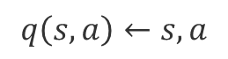
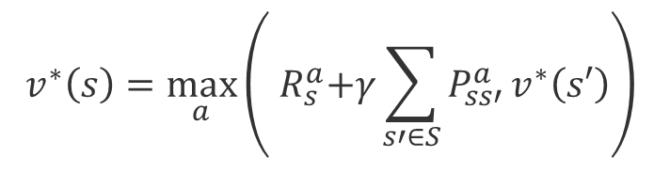
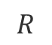
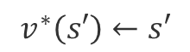
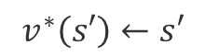
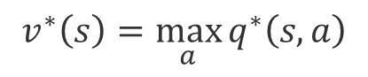
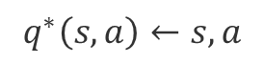
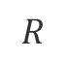
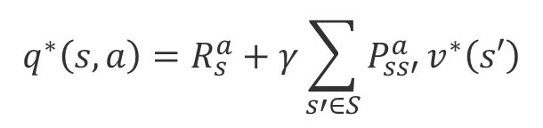
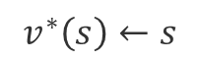
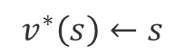
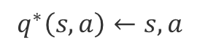
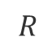
Bellman Optimality Equations for MDPs
$$v^{∗}\left(s\right)←s$$
$$v^{∗}\left(s\right)←s$$
$$R$$
$$q\left(s,a\right)←s,a$$
$$R$$
$$q^{∗}\left(s,a\right)←s,a$$
$$R$$
$$q^{∗}\left(s,a\right)←s,a$$
$$v^{∗}\left(s′\right)←s′$$
$$v^{∗}\left(s′\right)←s′$$
$$q^{∗}\left(s,a\right)=R_{s}^{a}+γ\sum_{s′∈S}{P_{ss′}^{a}}v^{∗}\left(s′\right)$$
$$v^{∗}\left(s\right)=\max_{a}{q^{∗}\left(s,a\right)}$$
$$v^{∗}\left(s\right)=\max_{a}\left({ R}_{s}^{a}+γ\sum_{s′∈S}{P_{ss′}^{a}}v^{∗}\left(s′\right)\right)$$
The value function of a state is the maximum that I can get after taking an action
The optimal value is the expected return of the multiple states that we can end up after taking action a

Slide 16
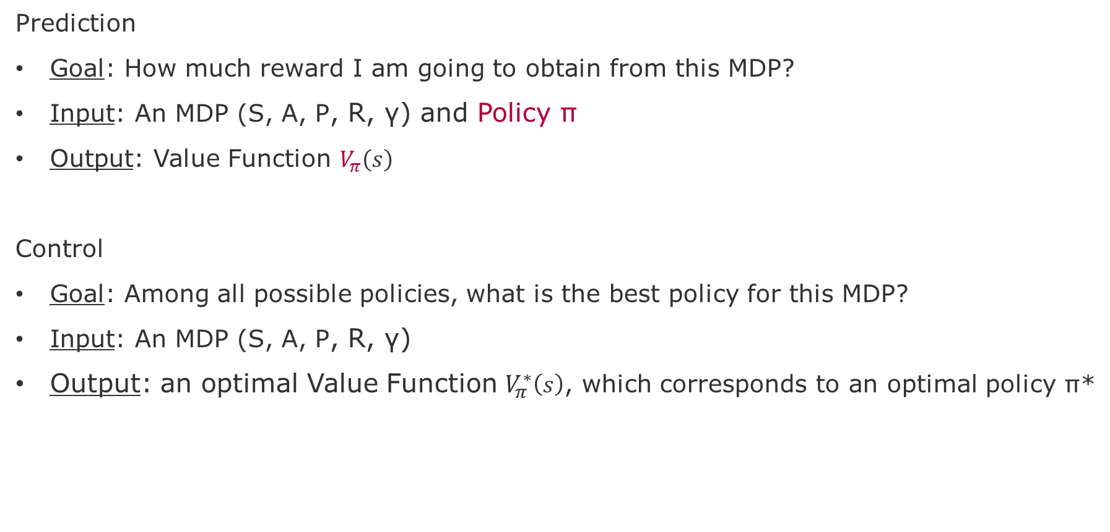
Prediction versus Control Problems
Prediction
Goal: How much reward I am going to obtain from this MDP?
Input: An MDP (S, A, P, R, γ) and Policy ϖ
Output: Value Function $V_{π}\left(s\right)$
Control
Goal: Among all possible policies, what is the best policy for this MDP?
Input: An MDP (S, A, P, R, γ)
Output: an optimal Value Function $V_{π}^{∗}\left(s\right)$, which corresponds to an optimal policy ϖ*
Control
For-loop:
Prediction

Slide 17
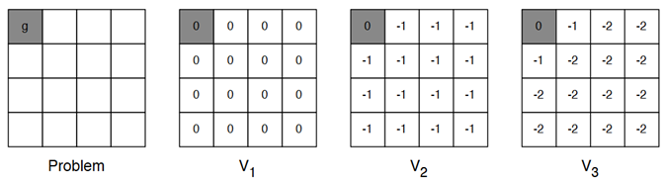
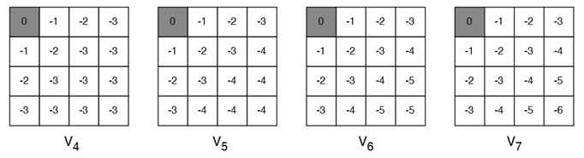
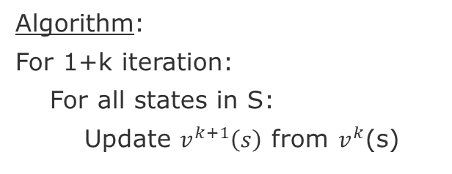
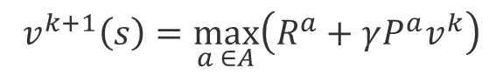
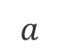
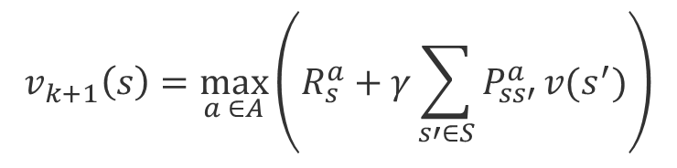
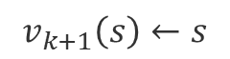
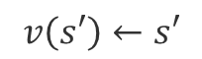

Value Iteration
$$v_{k+1}\left(s\right)←s$$
Algorithm:
For 1+k iteration:
For all states in S:
Update $v^{k+1}\left(s\right)$ from $v^{k}$(s)
$$a$$
$$R$$
$$v\left(s′\right)←s′$$
$$v_{k+1}\left(s\right)=\max_{a ∈A}\left(R_{s}^{a}+γ\sum_{s′∈S}{P_{ss′}^{a}}v(s^{′})\right)$$
$$v^{k+1}\left(s\right)=\max_{a ∈A}\left(R^{a}+γP^{a}v^{k}\right)$$
Source: Silver, 2015, https://www.davidsilver.uk/wp-content/uploads/2020/03/DP.pdf

Slide 18
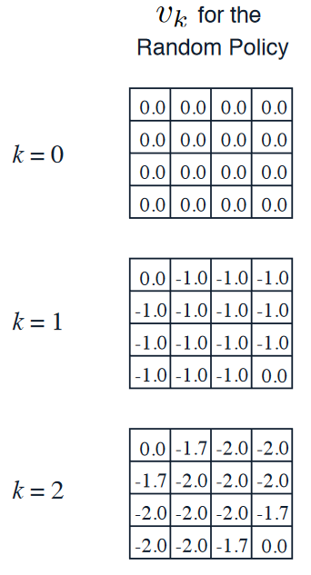
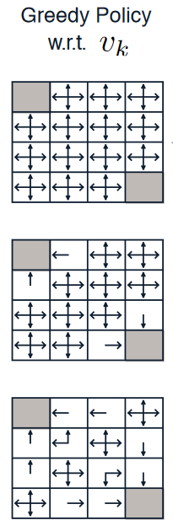
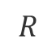
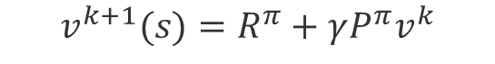
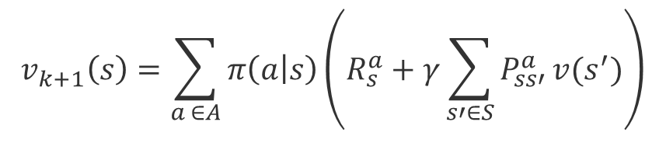
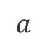

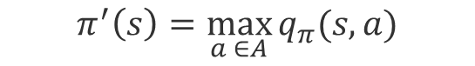
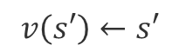
Policy Evaluation and Policy Iteration
$$v_{k+1}\left(s\right)←s$$
$$a$$
$$R$$
$$v\left(s′\right)←s′$$
One step lookahead
$$v_{k+1}\left(s\right)=\sum_{a ∈A}{π\left(a | s\right)\left(R_{s}^{a}+γ\sum_{s′∈S}{P_{ss′}^{a}}v(s^{′})\right)}$$
current Reward
discounted future Reward
Evaluate:
$$v^{k+1}(s)=R^{π}+γP^{π}v^{k}$$
Improve:
$$π^{′}\left(s\right)=\max_{a ∈A}{q_{π}(s,a)}$$
Greedy!
Source: Silver, 2015, https://www.davidsilver.uk/wp-content/uploads/2020/03/DP.pdf

Slide 19
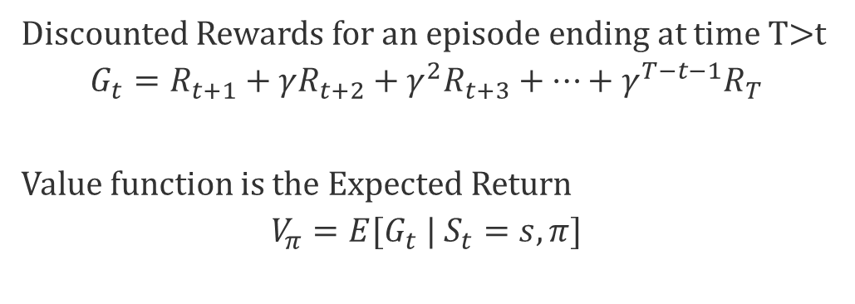
Monte Carlo Policy Evaluation
Sample the rewards for each action across multiple Episodes
Similar to what we have seen in the Multi-Armed Bandits
Discounted Rewards for an episode ending at time T>t
$$G_{t}=R_{t+1}+γR_{t+2}+{γ_{ }^{2}R}_{t+3}+…+{γ_{ }^{T−t−1}R}_{T}$$
Value function is the Expected Return
$$V_{π}=E{[G}_{t} | S_{t}=s,π]$$
Caveat: Multiple episodes necessary to update the state value function under a policy $V_{π}\left(S\right)$

Slide 20
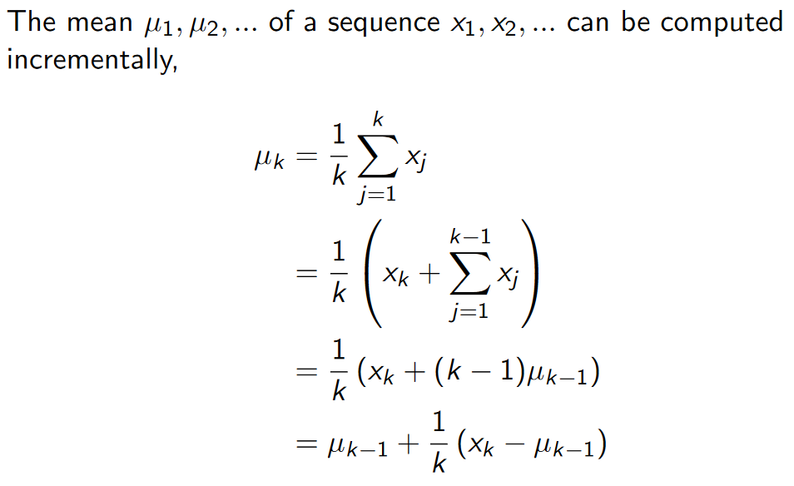
Incremental Mean Trick
Source: Silver, 2015, https://www.davidsilver.uk/wp-content/uploads/2020/03/MC-TD.pdf

Slide 21
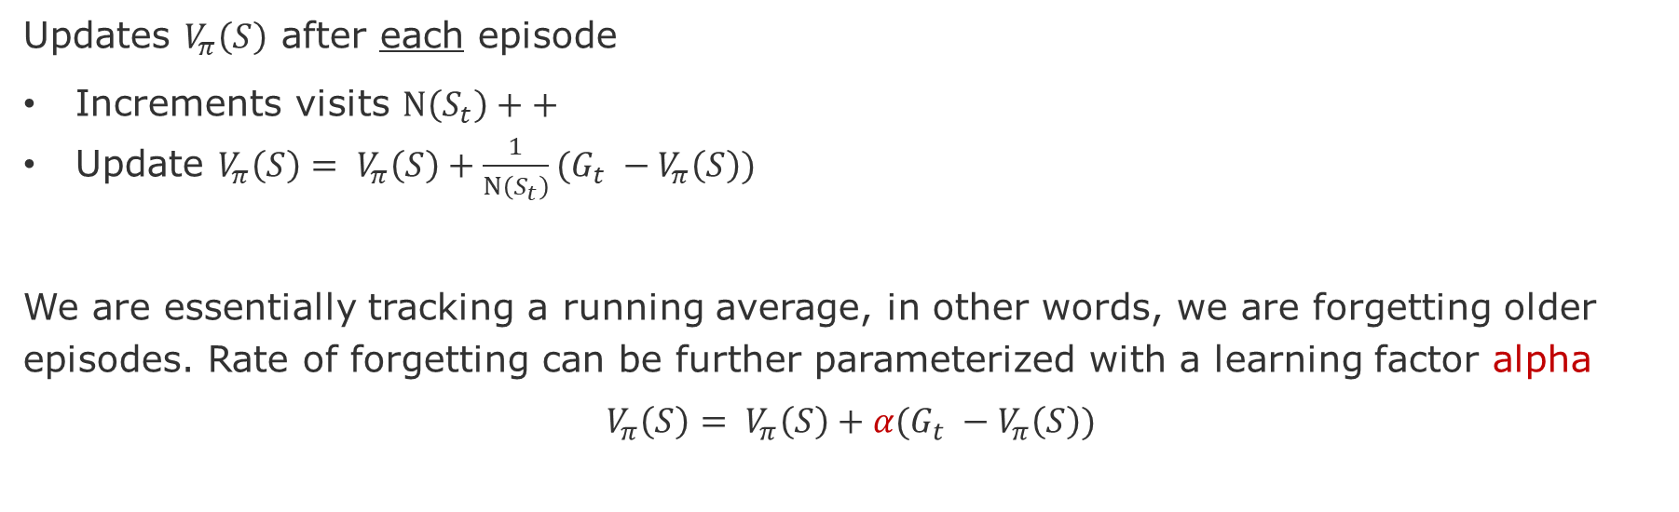
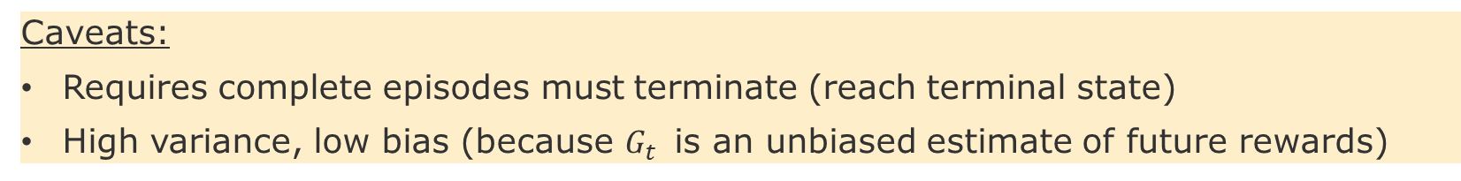
Incremental Monte Carlo Updates
Updates $V_{π}\left(S\right)$ after each episode
Increments visits $N\left(S_{t}\right)++$
Update $V_{π}\left(S\right)= V_{π}\left(S\right)+\frac{1}{N\left(S_{t}\right)}(G_{t} −V_{π}\left(S\right))$
We are essentially tracking a running average, in other words, we are forgetting older episodes. Rate of forgetting can be further parameterized with a learning factor alpha
$$V_{π}\left(S\right)= V_{π}\left(S\right)+α(G_{t} −V_{π}\left(S\right))$$
Advantages:
Non-stationary estimator
Memoryless algorithms
Caveats:
Requires complete episodes must terminate (reach terminal state)
High variance, low bias (because $G_{t}$ is an unbiased estimate of future rewards)

Slide 22
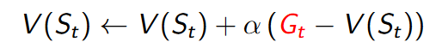


Temporal Difference Learning
Recalling Policy Iteration
$$v^{t+1}\left(s\right)=R^{π}+γP^{π}v^{t}$$
$$v_{t+1}\left(S_{t}\right)=E{[R}_{t+1 }+γv_{t}\left(S_{t+1}\right)| S_{t}=s,A_{t \sim }π{(s}_{t})]$$
Bootstrapping
Monte Carlo
TD Learning
TD-Error
Advantages:
Updates with partial episodes
Size of partial episode is parameterizable (lambda)
Caveat: High Bias, but less variance (because update depends on only one action)

Slide 23

Batch Learning = Limited Budget
The batch dataset has 8 episodes with the following (state, return) values
Episode | Data
1 | (A,0), (B,0)
2 | (B,1)
3 | (B,1)
4 | (B,1)
5 | (B,1)
6 | (B,1)
7 | (B,1)
8 | (B,0)
What are the value function estimates for A and B?
Monte Carlo:
(A) = 0/8 = 0,
V(B) = 6/8 = 0.75
Temporal Difference:
V(A) = R(A) + [R(B) + V(B) - V(A)] = 0.75
V(B) = 0.75

Slide 24


Temporal Difference (TD) vs Monte Carlo (MC)
source: page 125 [Sutton & Barto 2018]
Notes:
Left plot: TD learning approximate true value of the states (black line) after 100 steps.
Right plot:
RMSE – Root mean-squared error between the value function learned and the true value
function, averaged over the five states, then averaged over 100 runs.
Low step size in makes TD and MC error curves smoother, however it takes longer to drop. Both converge to the trur value, but MC is noisier (higher variance).
Larger step size makes TD approximate faster, but it stabilizes at a higher error level.

Slide 25

Summary of pros and cons
Monte Carlo
High Variance, Low Bias
Good Convergence properties (even with function approximation)
Not very sensitive to initial values
Simple to understand and use
More efficient in non-Markov environments, because it does not explore the Markov Property
TD
Low Variance, High Bias
TD(zero) converges to $v_{π}(s)$(not always with function approximation)
More sensitive to initial values
More efficient in Markov environments, because it does explore the Markov Property

Slide 26




Comparing the three models
Monte Carlo
Temporal Difference
Bootstrapping: updating = to estimate
MC does not bootstrap
DP and TD bootstrap
Sampling: updating = to sample an expectation
MC and TD sample
DP does not sample
Dynamic programming

Slide 27


Trade-off between TD(0) and MC = TD(lambda)
Which n-value is the best?
Alpha = Learning rate
Gamma = Discount rate

Slide 28

TD(λ) Which n value is the best?

Slide 29
Control Improving the policy to find optimal value-function
Notes:
https://en.wikipedia.org/wiki/Transduction_(machine_learning)

Slide 30


Generalized Policy Iteration
Convergence
ϖ* ==V*
Policy Evaluation:
What? estimates V^{ϖ}
How? Iterative policy evaluation
Policy Improvement:
What? generates a ϖ’ ≥ ϖ
How? Greedy policy improvement
Variations to these components:
Monte Carlo Evaluation
epsilon-Greedy (fixed exploration rate)
Monte Carlo GLIE (decaying exploratoin rate)
TD(0) and TD(lambda)
Notes:
We will vary these two components.

Slide 31



Monte Carlo Control
V(s) = how good a state s is (expected total reward starting from s following the policy).
Solution part-1: use Q because it is based on state, action pairs
$$v^{k+1}\left(s\right)=\max_{a ∈A}\left(R^{a}+γP^{a}v^{k}\right)$$
Q(s, a) = how good it is to take action a in state s (expected total reward if you do a, then follow the policy)
No guarantee that will find the optimum
Control
for-loop:
Solution part-2: add randomness in the choice of action (e-Greedy)
Prediction
Notes:
🧩 1. The Goal in Reinforcement Learning
In reinforcement learning (RL), the agent wants to learn how to act in order to get the most total reward in the long run.
It does this by learning a policy — a mapping from states (situations) to actions (what to do). The “best” policy is the one that maximizes expected cumulative reward — that’s what we mean by the optimal policy.
To reach that goal, the agent usually needs to estimate something called a value function:
V(s) = how good a state s is (expected total reward starting from s following the policy).
Q(s, a) = how good it is to take action a in state s (expected total reward if you do a, then follow the policy).
🧠 2. Iterative Policy Evaluation (Monte Carlo style)
Monte Carlo (MC) methods are one way to estimate the value function.
You let the agent follow a policy many times, collect full episodes of experience (state → action → reward → next state → ...), and average the returns to estimate how good each state (or state-action pair) is.
For example:
If every time you start in state A and follow the policy you get about +5 total reward on average, then V(A) ≈ 5.
That’s policy evaluation — learning what happens if you follow the current policy.
⚠️ 3. The Problem: You might never find the optimal policy
Monte Carlo methods by themselves just evaluate whatever policy you’re currently using — they don’t improve it unless you explicitly change it.
If your policy is bad (say, it never tries new actions), you might never discover better actions. So even though your value estimates (V) get more accurate for the current policy, the policy itself stays stuck — and therefore you may never find the optimal value function or the optimal policy.
🛠️ 4. First Fix: Use Q-values instead of V-values
If you only use V(s), you know how good a state is — but not which action inside that state led to it. So you can’t easily decide which actions to change.
If you use Q(s, a), now you know:
“If I’m in state s, how good is each possible action a?”
This lets you compare actions directly and choose the best one — that’s called policy improvement.
So Q-learning and similar methods use Q-values to update the policy toward better actions.
🎲 5. Second Fix: Add Randomness (ε-Greedy)
Even with Q-values, you can still get stuck: If you always choose the action with the highest Q(s, a) (a greedy policy), you might never explore new actions that could actually be better.
So we add a bit of randomness:
With probability ε, choose a random action (explore).
With probability 1−ε, choose the best known action (exploit).
This is called ε-greedy exploration. It ensures that you keep trying new things occasionally, which allows you to improve your estimates of Q(s, a) and move closer to the optimal policy.
🧭 6. Putting it all together
Step Concept Purpose 1 Iterative Policy Evaluation (MC) Estimate how good a policy is based on experience 2 Switch from V(s) to Q(s, a) Learn which actions are good, not just which states 3 ε-Greedy Exploration Avoid getting stuck — keep exploring so you can find better actions Together, these ideas form the foundation for control in reinforcement learning — improving a policy until it becomes optimal.
🌟 Intuitive Analogy
Imagine you’re trying to find the best restaurant in a new city:
Policy evaluation (V): You always go to the same place and rate how much you like it. You know how good that choice is, but not others.
Q-learning (Q): You track how much you like each restaurant (state-action pair). Now you can compare and choose.
ε-greedy: Even if you have a favorite, sometimes you try a random new place — maybe it’s even better.
Over time, this balance between learning what works and exploring what might work better lets you discover the optimal restaurant — or, in RL terms, the optimal policy.
Would you like me to also show a small diagram or pseudocode (with intuition) of how ε-greedy Q-learning updates the policy? It can make the concept click even more clearly.

Slide 32

GLIE Monte Carlo Control
GLIE – Greedy in the Limit with Infinite in the limit Exploration
Decays epsilon, for instance ε
$ε=\frac{1}{k}$, where k is the episode count
All <state,action> pairs are explored indefinitely
$$\lim_{k→∞}N_{k}\left(s,a\right)= ∞$$
The policy ϖ converges to a greedy policy
$$\lim_{k→∞}{π_{k}\left(s,a\right)=I(a= \max_{a′}{q_{k}(s,a′)})}$$
Theorem shows that it also converges to the optimal value-function
$$\lim_{k→∞}{π_{k}\left(s,a\right)=I(a= \max_{a′}{q_{k}(s,a′)})}$$
Advantage: Converges to the optimal greedy policy
Caveat: Still expensive, even with partial episodes

Slide 33

On-Policy versus Off-Policy Control
On-Policy
Learn on the job
How? Learn about policy $π$ from experience sampled from $π$
Off-Policy
Look over someone else’s shoulder
How? Learn about policy $π$ from experience sampled from the environment

Slide 34





Sarsa: On-Policy TD Control
Advantage: Converges to the optimal greedy policy
Caveat: Still expensive, even with partial episodes

Slide 35

Q-Learning: off-policy TD Control
Choose among all possible actions

Slide 36
Comparing Sarsa and Q-Learning
Q-Learning does not follow any given policy to update the Q-value
However, Q-Learning still follows a “behavioral” policy in order to determine which state-action pairs to visit

Slide 37

Trade-off between Sarsa and Q-Learning
Gridworld example from [Sutton & Barto 2018] page 132.
Goal: is to go from S to G avoiding the Cliff.

Slide 38


N-Step Sarsa TD(λ)

Slide 39
More Recent Methods
DQN
Policy Gradient
A2C, A3C
PPO
TRPO
DDPG
SAC

Slide 40
Deep Reinforcement Learning
Notes:
https://en.wikipedia.org/wiki/Transduction_(machine_learning)
https://stats.stackexchange.com/questions/568821/is-there-a-good-illustrative-example-where-the-hinge-loss-svm-gives-a-higher-a
Vapnik wrote this in the context of transductive learning, but the principle could also be applied to statistical pattern recognition tasks. If we just need to perform a hard classification, then we should aim to determine the decision boundary directly, rather than estimating the posterior probability of class membership and then threshold that at 0.5 (or some other threshold depending on the misclassification costs).
In principle, we may be able to get better generalisation in terms of accuracy by following this principle as it focusses on the needs of the application, and avoids modelling compromises that benefit modelling of aspects of the data that are not relevant to the application at the expense of other aspects that are.

Slide 41


DQN - Deep Q-Network [Mnih 2013]
Q-Table
State
Action
Grows too large for continuous state-spaces
Q-value
Q-function
State
Action
F
Q-value
Like Double-Q-Learning, DQN is initialized with arbitrary Q-values and explores the environment using the ε-greedy policy.
It updates its Q-value via dual actions:
a current action with a current Q-value
a target action with a target Q-value
Q-network
State
Action
Q-value
Mnih, V., Kavukcuoglu, K., Silver, D., Graves, A., Antonoglou, I., Wierstra, D., & Riedmiller, M. (2013). Playing atari with deep reinforcement learning. arXiv preprint arXiv:1312.5602.

Slide 42
DQN - Components [Mnih 2013]
Experience Replay
Replay Buffer
Environment
Actual network
Target network
There is no restriction on the neural network architecture itself. Therefore, one could use:
RNN for Text
CNN for Images
LSTM for regular data
GNN for graph data?
Which ever choice of network architecture, both actual and target networks should have the same architecture
Mnih, V., Kavukcuoglu, K., Silver, D., Graves, A., Antonoglou, I., Wierstra, D., & Riedmiller, M. (2013). Playing atari with deep reinforcement learning. arXiv preprint arXiv:1312.5602.

Slide 43
DQN – Why experience replay?
trained it with single samples, each sample and the corresponding gradients would have too much variance, and the network weights would never converge.
Why few actions in sequence one after the other and then feed that data as a batch to the Q Network? That should help to smoothen out the noise and result in more stable training, shouldn’t it?
Deep Learning best practice requires selecting a batch of samples after shuffling to ensure enough diversity in the training so the network can generalize
Sequential actions are strongly correlated. Replay buffer allows to make the data i.i.d. which is necessary for training a neural net.
Why i.i.d. matters?
Identically Distributed allows to build a prediction model of Y given a set of features, e.g., P(Yi|Xi)
Independent guarantees the rows in the data present new information to train the model and sufficient (but not necessary condition) for:
For consistency and providing error bounds
For random sampling techniques
Notes:
https://stats.stackexchange.com/questions/213464/on-the-importance-of-the-i-i-d-assumption-in-statistical-learning

Slide 44
DQN – Why do we need a Target Network?
Because it is more stable
Note that the target network doesn’t get trained, therefore, its weights remain stable for at least a short period.
After a parameterized number of time-steps, the learned weights from the Q Network are copied over to the Target Network.

Slide 45
DQN – Training Process
Predict Q-Values on
Q-Network
Experience replay collects training samples by interacting with the environment
Sample a random batch of data from the replay buffer
Predict Q-Values on
Target-Network
Every T steps, overwrite the Target-Network weight with the current Q-Network weights
Train Q-Network
Keep Target-Network fixed
Compute loss

Slide 46
Policy Gradient Optimization
How do we learn the parameters θ of the prediction model?

Slide 47

Policy Gradient Optimization - Setup
We start with a parameterized policy $π_{θ}\left(a∣s\right)$, where $θ$are the policy parameters.
The objective function in reinforcement learning is the expected return:
$$J\left(θ\right)=𝔼_{π_{θ}}[G_{t}]$$
where $G_{t}=\sum_{k=0}^{∞}{γ^{k}}r_{t+k}$is the discounted return.
We can equivalently express this as:
$$J\left(θ\right)=\sum_{s}{d^{π_{θ}}}\left(s\right)\sum_{a}{π_{θ}}\left(a∣s\right)Q^{π_{θ}}\left(s , a\right)$$
where:
$d^{π_{θ}}\left(s\right)$is the stationary distribution of states under the policy $π_{θ}$,
$Q^{π_{θ}}\left(s , a\right)$is the action-value function.

Slide 48

Policy Gradient Optimization – Taking the Gradient
We want $∇_{θ}J\left(θ\right)$.
$$∇_{θ}J\left(θ\right)=∇_{θ}\sum_{s}{d^{π_{θ}}}\left(s\right)\sum_{a}{π_{θ}}\left(a∣s\right)Q^{π_{θ}}\left(s , a\right)$$
This is tricky because both $d^{π_{θ}}\left(s\right)$and $Q^{π_{θ}}\left(s , a\right)$depend on $θ$. The policy gradient theorem uses the chain rule cleverly to simplify this dependency.

Slide 49

Policy Gradient Optimization – Using the Log-Derivative Trick (Chain Rule)
Start with the gradient through the policy:
$$∇_{θ}π_{θ}\left(a∣s\right)=π_{θ}\left(a∣s\right)∇_{θ}\log{π_{θ}}\left(a∣s\right)$$
Then:
$$∇_{θ}J\left(θ\right)=\sum_{s}{d^{π_{θ}}}\left(s\right)\sum_{a}{∇_{θ}}π_{θ}\left(a∣s\right)Q^{π_{θ}}\left(s , a\right)$$
Substitute the log-derivative:
$$∇_{θ}J\left(θ\right)=\sum_{s}{d^{π_{θ}}}\left(s\right)\sum_{a}{π_{θ}}\left(a∣s\right)∇_{θ}\log{π_{θ}}\left(a∣s\right)Q^{π_{θ}}\left(s , a\right)$$
Taking expectations over trajectories generated by $π_{θ}$:
$$∇_{θ}J\left(θ\right)=𝔼_{s∼d^{π_{θ}},a∼π_{θ}}[∇_{θ}\log{π_{θ}}\left(a∣s\right) Q^{π_{θ}}\left(s , a\right)]$$
This is the policy gradient theorem.

Slide 50

Policy Gradient Optimization – Chain Rule in the Q-Function
Sometimes we need to express how $Q^{π_{θ}}\left(s , a\right)$itself depends on $θ$. Then, by the Bellman equation:
$$Q^{π_{θ}}\left(s , a\right)=r\left(s , a\right)+γ\sum_{s^{′}}{P}\left(s^{′} , ∣sa\right)\sum_{a^{′}}{π_{θ}}\left(a^{′}∣s^{′}\right)Q^{π_{θ}}\left(s^{′} , a^{′}\right)$$
Taking $∇_{θ}$on both sides gives (applying the chain rule):
$$∇_{θ}Q^{π_{θ}}\left(s , a\right)=γ\sum_{s^{′}}{P}\left(s^{′} , ∣sa\right)\sum_{a^{′}}{[}∇_{θ}π_{θ}\left(a^{′}∣s^{′}\right)Q^{π_{θ}}\left(s^{′} , a^{′}\right)+π_{θ}\left(a^{′}∣s^{′}\right)∇_{θ}Q^{π_{θ}}\left(s^{′} , a^{′}\right)]$$
This recursive expression shows how $Q^{π_{θ}}\left(s , a\right)$depends on the policy parameters via both direct ($π_{θ}\left(a^{′}∣s^{′}\right)$) and indirect ($Q^{π_{θ}}\left(s^{′} , a^{′}\right)$) dependencies.
However, the policy gradient theorem proves that we do not need to compute $∇_{θ}Q^{π_{θ}}$ explicitly — it cancels out due to the chain rule and the Markov property.

Slide 51

Policy Gradient Optimization – Final Simplified Gradient
Thus, the final form of the gradient is:
$$\boxed{∇_{θ}J\left(θ\right)=𝔼_{π_{θ}}[∇_{θ}\log{π_{θ}}\left(a∣s\right) Q^{π_{θ}}\left(s , a\right)]}$$
Or equivalently, using the advantage function $A^{π_{θ}}\left(s , a\right)=Q^{π_{θ}}\left(s , a\right)−V^{π_{θ}}\left(s\right)$:
$$∇_{θ}J\left(θ\right)=𝔼_{π_{θ}}[∇_{θ}\log{π_{θ}}\left(a∣s\right) A^{π_{θ}}\left(s , a\right)]$$

Slide 52
Applying the math to DQN – Deep Q-Learning

Slide 53

Deep Q-learning - DQN
Q-Learning Objective
In standard Q-learning, the goal is to approximate the optimal action-value function:
$$Q^{∗}\left(s , a\right)=𝔼[r_{t}+γ\underset{a^{′}}{\max{}}Q^{∗}\left(s^{′} , a^{′}\right) ∣ s,a]$$
DQN parameterizes the Q-function with a neural network $Q\left(s , a , θ\right)$, where $θ$are the learnable weights.

Slide 54

Deep Q-learning - DQN
Temporal Difference (TD) Target
Given a transition $\left(s , a , r , s^{′}\right)$, we define the TD target as:
$$y=r+γ\underset{a^{′}}{\max{}}Q\left(s^{′} , a^{′} , θ^{−}\right)$$
Here:
$θ^{−}$are the parameters of a target network (a periodically updated copy of the main network),
$γ∈\left[0 , 1\right)$is the discount factor.

Slide 55

Deep Q-learning – LOSS Function
DQN Loss Function
The mean-squared error (MSE) loss for a mini-batch of transitions is:
$$L\left(θ\right)=𝔼_{\left(s , a , r , s^{′}\right)∼D}[(y−Q\left(s , a , θ\right))^{2}]$$
where $D$is the replay buffer distribution.
Substitute $y$:
$$L\left(θ\right)=𝔼[(r+γ\underset{a^{′}}{\max{ }}Q\left(s^{′} , a^{′} , θ^{−}\right)−Q\left(s , a , θ\right))^{2}]$$

Slide 56

Deep Q-learning – Gradient of Loss Function
Gradient of the Loss (Using the Chain Rule)
We now take the gradient of the loss $L\left(θ\right)$with respect to $θ$:
$$∇_{θ}L\left(θ\right)=𝔼[2(Q\left(s , a , θ\right)−y) ∇_{θ}Q\left(s , a , θ\right)]$$
This follows from the chain rule:
$$∇_{θ}(\left(y−Q{\left.)\right.}^{2})=2\left(y−Q\right)\left(−∇_{θ}Q\right)=2\left(Q−y\right)∇_{θ}Q\right.$$
Since the target $y$ does not depend on $θ,$ it uses $θ^{−}$), its gradient is zero.

Slide 57

Deep Q-learning – Parameter $θ$update
Parameter Update Rule
Using gradient descent, the update rule for $θ$becomes:
$$\boxed{θ←θ−α ∇_{θ}L\left(θ\right)}$$
Substituting the gradient:
$$θ←θ−α 𝔼[\left(Q\left(s , a , θ\right)−y\right) ∇_{θ}Q\left(s , a , θ\right)]$$

Slide 58

Deep Q-learning – Update Target Network
Target Network Update (Soft or Hard)
To stabilize learning, DQN uses a target network $Q\left(s , a , θ^{−}\right)$whose parameters are updated periodically or softly:
Hard update (every C steps):
$$θ^{−}←θ$$
Soft update (used in DDQN variants):
$$θ^{−}←τθ+\left(1−τ\right)θ^{−}$$
with $τ≪1$.

Slide 59

Deep Q-learning - Summary
Concept | Formula
TD target | $$y=r+γ\underset{a^{′}}{\max{ }}Q\left(s^{′} , a^{′} , θ^{−}\right)$$
Loss | $$L(θ)=E[{\left(y−Q\left(s,a;θ\right)\right)}^{2}]$$
Gradient of the Loss | $$∇θ​L(θ)=E[2(Q(s,a;θ)−y)∇θ​Q(s,a;θ)]$$
Update | $$θ←θ−α(Q(s,a;θ)−y)∇θ​Q(s,a;θ)$$
Target network update (soft) | $θ^{−}←τθ+\left(1−τ\right)θ^{−}$

Slide 60
Interesting video lectures on RL
David Silver, 2015, University College London Lecture 1 https://www.youtube.com/watch?v=2pWv7GOvuf0 Course website: https://www.davidsilver.uk/teaching/ | Bottom-up explanations based on the math and introducing the simpler models before adding the complexity.
DeepMind series of Lectures https://www.deepmind.com/learning-resources/reinforcement-learning-lecture-series-2021 | Follows a similar format of David Silver’s lectures 2015.
Short 6 Lectures von Peter Abeel https://www.youtube.com/playlist?list=PLwRJQ4m4UJjNymuBM9RdmB3Z9N5-0IlY0 | Basics + Advanced methods like PPO, TRPO, DDPG.
Pascal Poupert, 2018, University of Waterloo, Canada Lecture 1b: https://www.youtube.com/watch?v=yOWBb0mqENw&list=PLdAoL1zKcqTXFJniO3Tqqn6xMBBL07EDc&index=2&pbjreload=10 Course website: https://cs.uwaterloo.ca/~ppoupart/teaching/cs885-spring20/schedule.html | More conceptual level with examples of applications.
Charles Isbell & Michael Littman, 2015, Georgia Tech https://www.youtube.com/watch?v=rETmf4NnlPM&list=PL__ycckD1ec_yNMjDl-Lq4-1ZqHcXqgm7&index=128&pbjreload=10 | Step-by-step explanations with fun discussions and lot of small examples to illustrate each core MDP principle
Nando Freitas, 2015, Lectures Oxford University, UK Lecture 15 https://www.youtube.com/watch?v=kUiR0RLmGCo Lecture 16 https://www.youtube.com/watch?v=dV80NAlEins Course Website: https://www.cs.ox.ac.uk/people/nando.defreitas/machinelearning/ | Lectures in the context of Deep Learning, but still provide the necessary concepts of RL.
2
1

Slide 61
Watch the lectures from Steven Katz
Reinforcement Learning Series: Overview of Methods
https://www.youtube.com/watch?v=i7q8bISGwMQ
Model Based Reinforcement Learning: Policy Iteration, Value Iteration, and Dynamic Programming
https://www.youtube.com/watch?v=sJIFUTITfBc&t=1296s
Q-Learning: Model Free Reinforcement Learning and Temporal Difference Learning
https://www.youtube.com/watch?v=0iqz4tcKN58
Reinforcement Learning: Machine Learning Meets Control Theory
https://www.youtube.com/watch?v=0MNVhXEX9to
Overview of Deep Reinforcement Learning Methods
https://www.youtube.com/watch?v=wDVteayWWvU&t=736s

Slide 62
End

